Slide 1
CE712 Course Project ID: 12 Module 2
Sahil Vijay Bhoge(210040132)
Rowthu Vivek(210040128)

Slide 2
Topic: Differentiating between cloud, ice and sand from multispectral imagery

Slide 3
Overview
In this project, we aimed to differentiate between clouds, ice, and sand using multispectral imagery. We began by collecting relevant datasets from Earth Explorer and importing necessary Python libraries. After downloading the required spectral band images, we converted the Digital Number (DN) values into NumPy arrays for efficient processing. We then calculated indices such as the Normalized Difference Snow Index (NDSI), a Cloud Index, and a Sand Index to highlight the unique spectral signatures of each surface type. By comparing the results of these indices, we effectively distinguished between clouds, ice, and sand in the imagery.

Slide 4
The process involved several key steps:
Data Acquisition:
For data acquisition, we used the USGS Earth Explorer platform to gather satellite imagery, selecting images that covered diverse surface types like deserts, polar areas, and cloud-prone regions. We specifically chose images with spectral bands crucial for our analysis, including the Blue, Green, Near-Infrared (NIR), and Short-Wave Infrared (SWIR) bands, as these are essential for calculating indices to differentiate between clouds, ice, and sand.
Importing python Libraries and required Images:
For data preparation, we imported essential Python libraries, including NumPy for numerical operations, rasterio and Matplotlib for visualizing results. We then converted the Digital Number (DN) values from the satellite images to reflectance values and required indices.

Slide 5
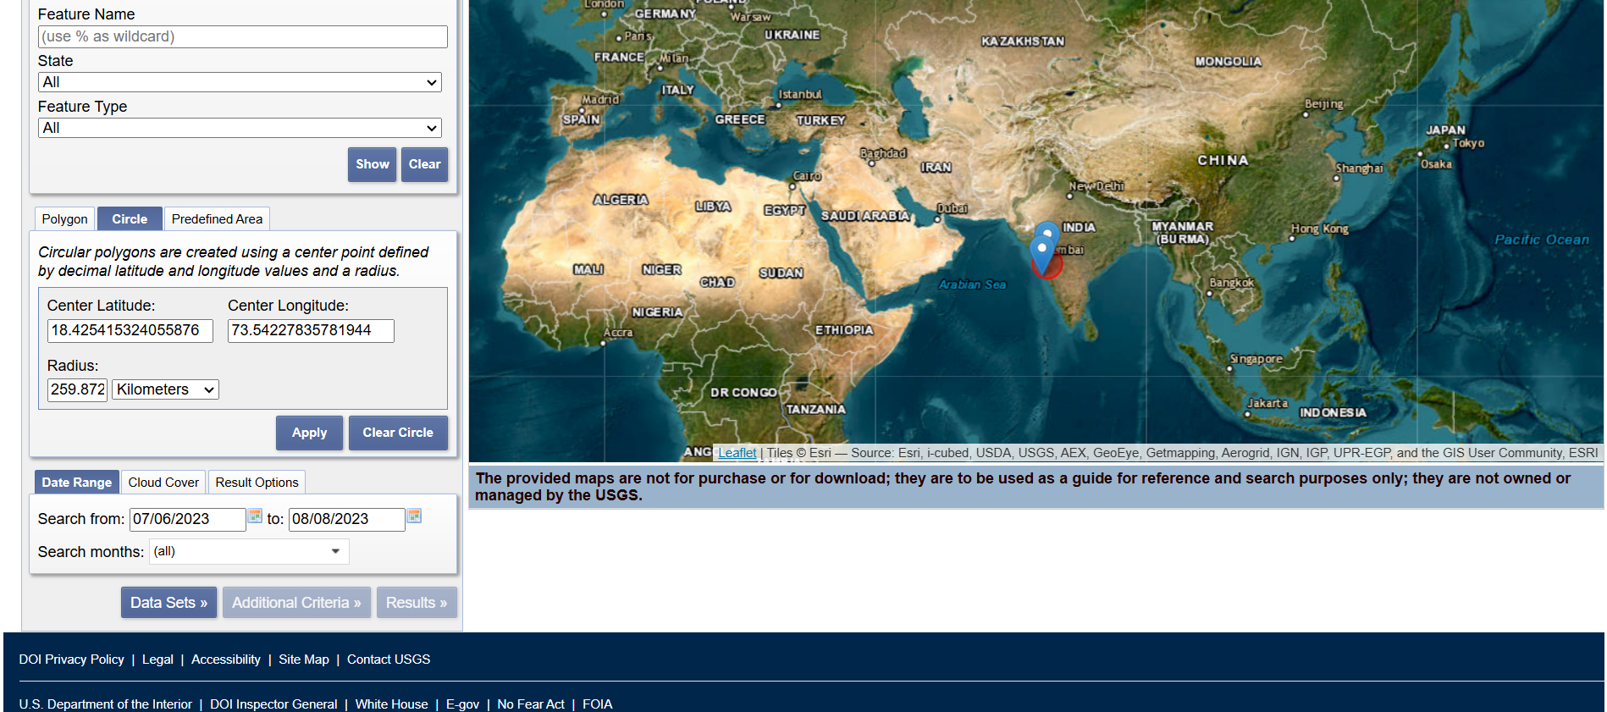
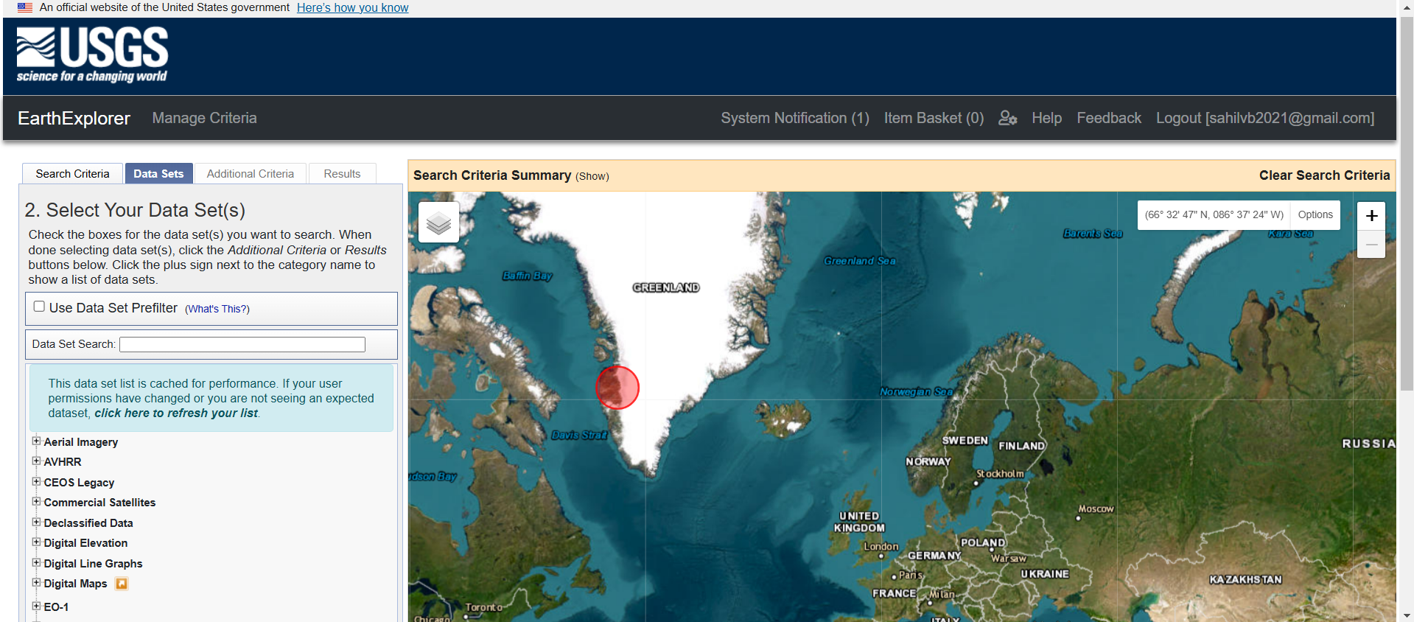
Earth Explorer was used to download satellite image needed for the Project

Slide 6
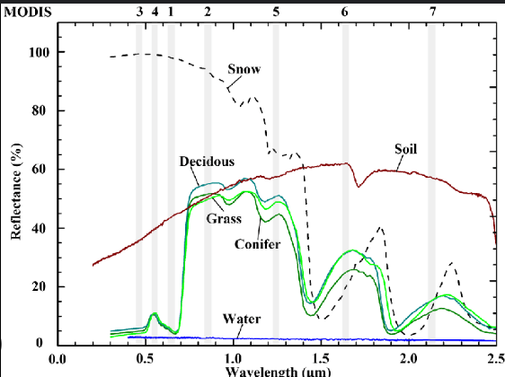
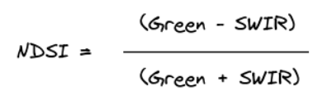
Snow Identification
We used the Normalized Difference Snow Index (NDSI) to identify snow.
Snow typically has high NDSI values because it reflects strongly in the Green band and less in the SWIR band.
We applied a threshold to the NDSI values to isolate pixels representing snow and ice.
This method effectively highlighted snow-covered areas, clearly distinguishing them from sand, and other surfaces as shown in next slide

Slide 7
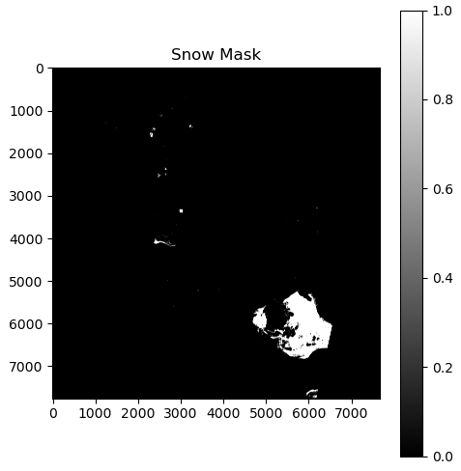
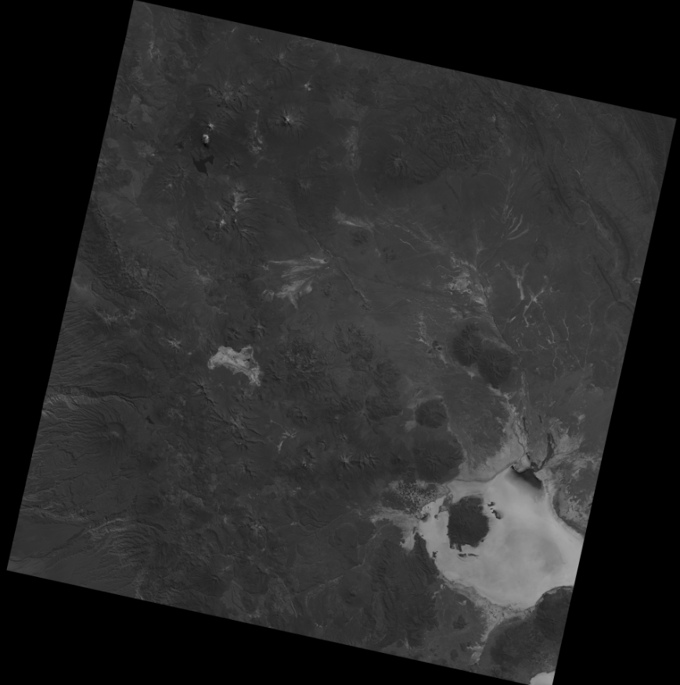
Raw image: Masked Image:

Slide 8
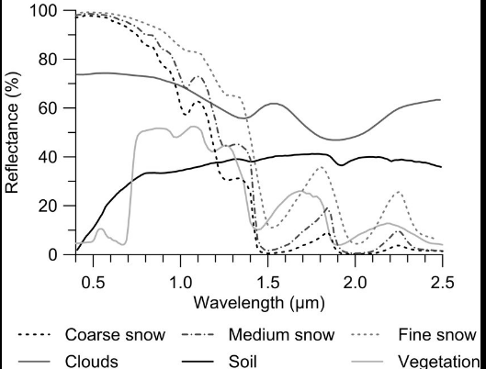
Cloud identification
We used the Cloud Index to identify clouds.
Clouds generally have high Cloud Index values due to their strong reflectance in the Blue band and lower reflectance in the SWIR and NIR band.
We also used cloud reflectance properties in NIR band and compared the results with the previous method
By setting a threshold on the Cloud Index values, we were able to distinguish cloud-covered pixels from other surfaces.
This approach effectively highlighted cloud areas, making it easy to separate them from snow, sand, and other land features.

Slide 9
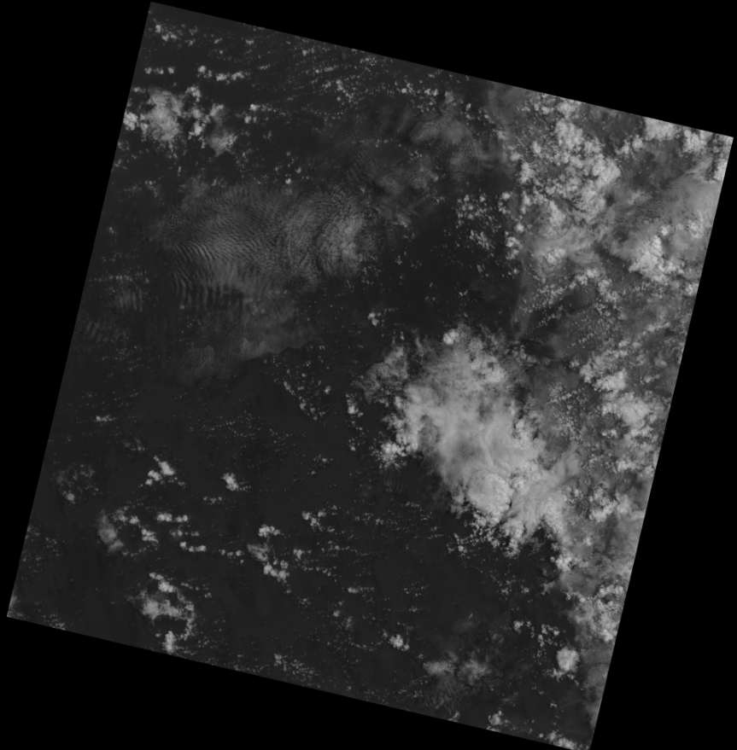
Original image used for cloud identification:

Slide 10
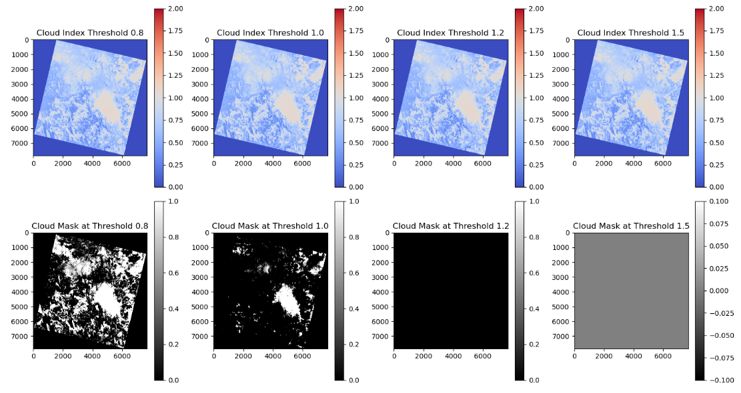
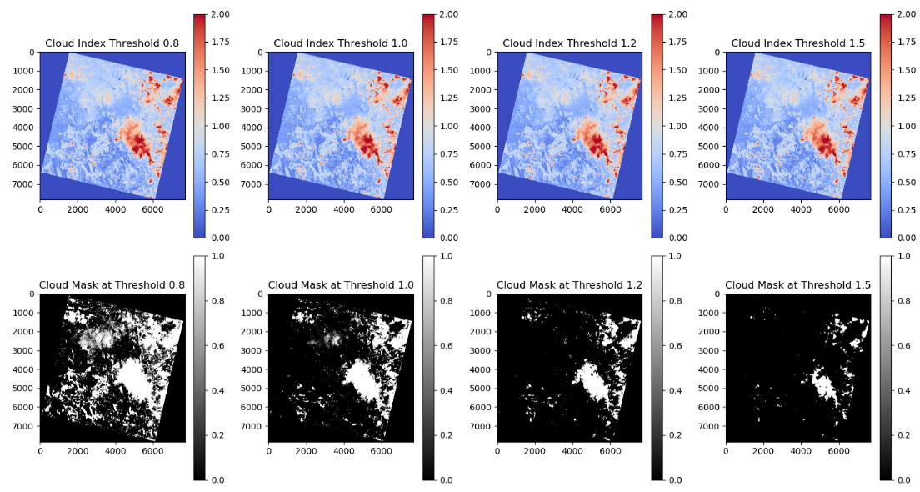
Using NIR band:
Using SWIR band:

Slide 11
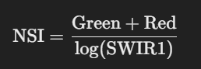
Sand identification
We used the Sand Index to identify sandy areas.
The Normalized Sand Index formula is:
Sand typically has high Sand Index values because it reflects more strongly in the Red band compared to the SWIR band.
By applying a threshold to the Sand Index values, we isolated pixels that represent sandy regions.
This method effectively highlighted sandy areas, allowing for clear differentiation of clouds from snow, and other surface types.

Slide 12
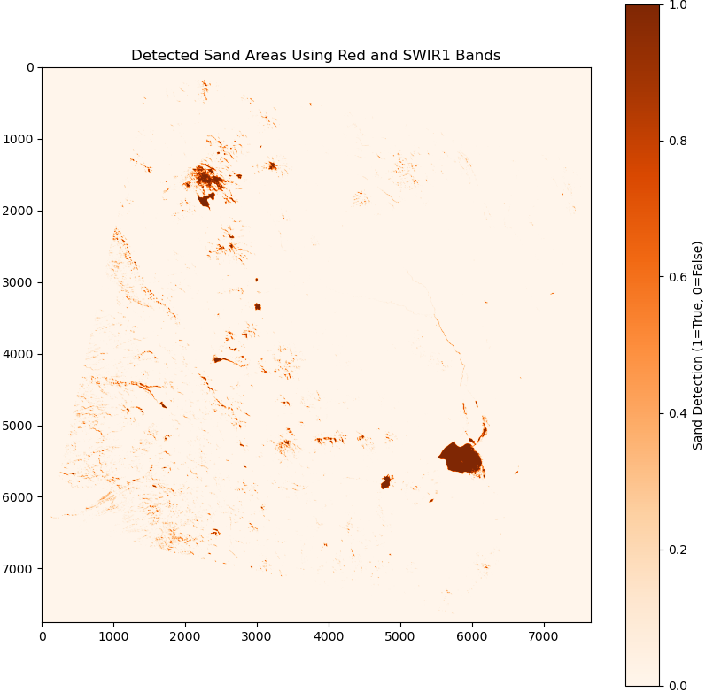
Original Image: Processed Image:

Slide 13
Reference:
CE712 slides
Tutorial 4
https://www.usgs.gov/landsat-missions/normalized-difference-snow-index
https://www.researchgate.net/figure/Representative-spectral-reflectance-of-snow-clouds-soil-and-vegetation-in-the-VIS-and_fig7_324383856
https://www.researchgate.net/figure/Spectral-reflectance-curves-of-snow-soil-vegetation-deciduous-conifer-and-grass-and_fig3_276291826
https://www.mdpi.com/2072-4292/14/15/3802

